Slide 1
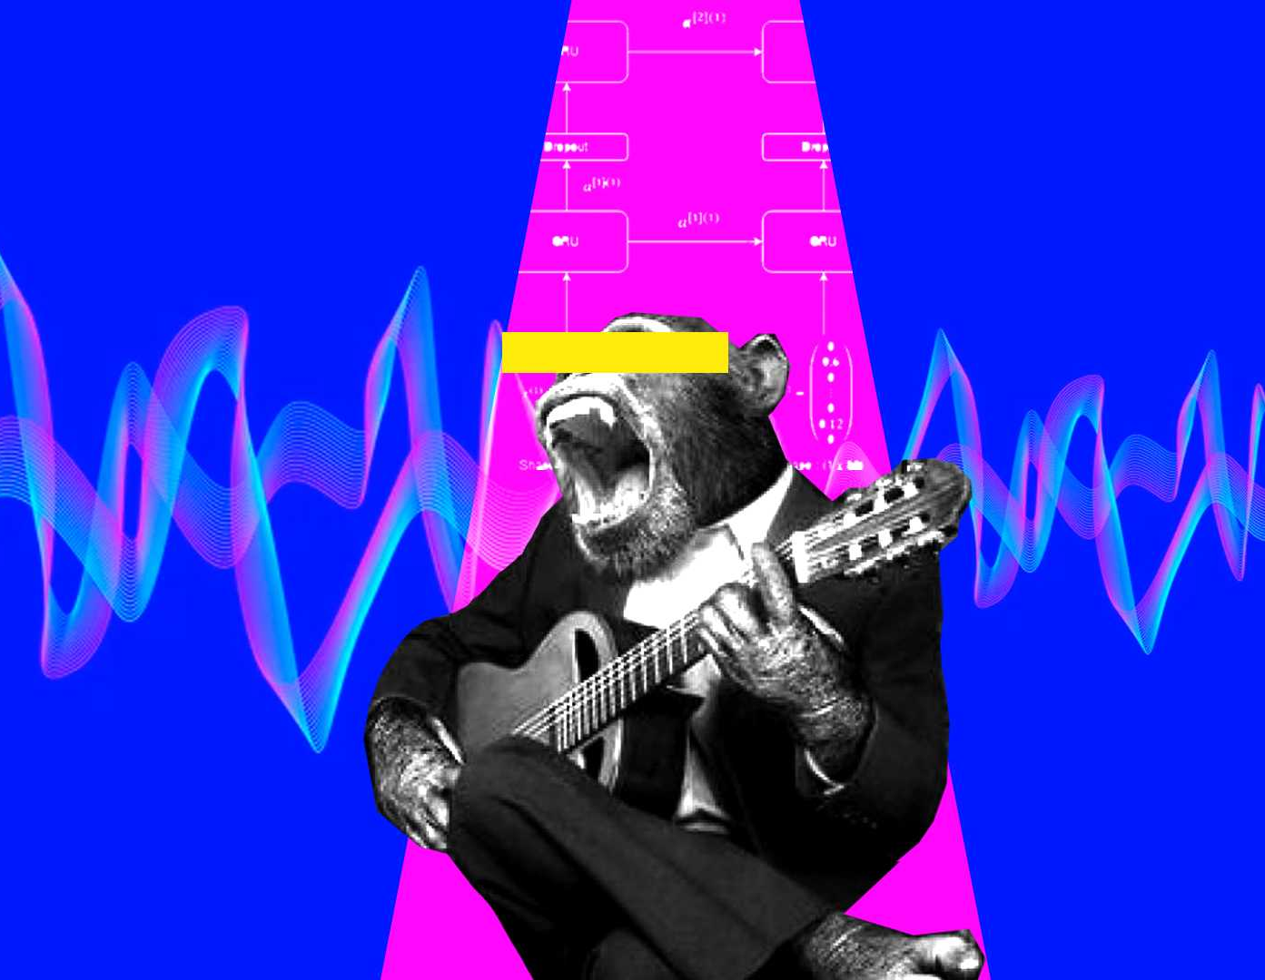
Automatic music generation
Mini project

Slide 2
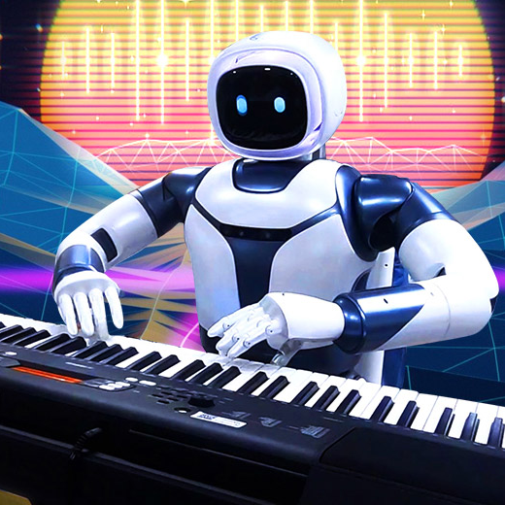
Introduction
Automatic music generation is a process where we compose a short piece of music with the least human intervention.
The audio data can be considered as a signal which has modulation with time like time series data. The data points are sequenced according to chronological order.
We use deep learning techniques for automatic music generation.
Notes:
What music generation is?
Why is it required?
How is it currently trending, getting used in music industry? (OPEN AI Jukebox)

Slide 3
Literature Survey

Slide 4
Music Generation Using an LSTM
This method presents the application of an LSTM network for music generation.
An RNN could be thought of as a regular neural network with the addition of the network’s input being the item of a sequence and with outputs dedicated to encoding and remembering state about the previous items sent through the network.
In this method, they use a more complex RNN with gates to control what information is passed through such as LSTM.
Since our network is a supervised model, we must provide a “correct” note that the model will compare its prediction with.

Slide 5
Pros:
Can generate different types of genres of music.
LSTM architecture performs good with sequential data.
Cons:
Works only with MIDI audio format.
These models do not know how to create beginnings and endings to pieces, rather, it just starts playing, and ends abruptly at some designated number of notes.
Cannot be able to differentiate between notes and chords and complex composition patterns.

Slide 6
Objective
Artificial generation of instrumental music trained on MIDI files using RNN and LSTM

Slide 7
Methodology
Data: Classical MIDI (from Kaggle) The MAESTRO Dataset (from Google AI)
Music stream is an ASCII based shorthand form of musical notation for computers. In musical terms, there are basically seven notes of the music system along with rests which are represented using letters a-g, A-G and z.
MIDI file format: Musical instrument Digital interface connects a wide variety of Electronic musical instruments, computers, and related audio devices for playing, editing and recording music. A single MIDI cable can carry up to 16 channels of MIDI data, each which can be routed to a separate device.

Slide 8
Design Criteria
To handle variable length sequences
01
To track long-term dependencies (memory)
02
To maintain information about the order
03
To share parameters across the sequence (weight sharing)
04
LSTM meet these sequence modeling design criteria.

Slide 9
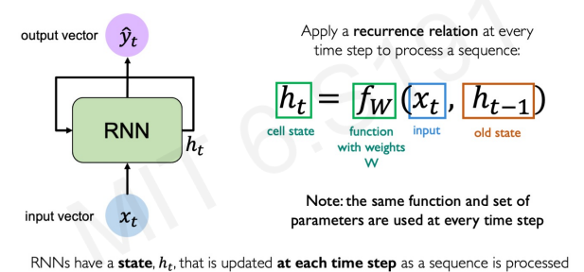

RNN is a deep sequence model, used for sequential processing of data. Here, MIDI file is a sequential data.
Here the outputs, ${\hat{y}}_{t}$not only depends on the current input $x_{t}$ but also on the past memory that had occurred $h_{t−1}$

Slide 10
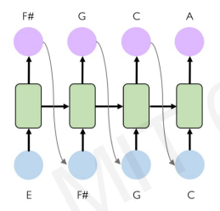

Slide 11
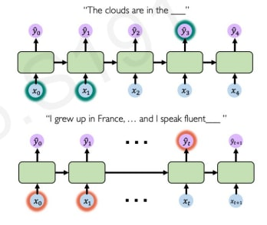
Problems with RNN
As the size of the time steps increases, standard RNNs become increasingly unable to connect the relevant information that’s because of vanishing gradient problem. (problem with long term dependencies)
To overcome this vanishing gradient problem, we can:
Choose proper activation function
Perform parameter initialization
Using gated cells (GRU, LSTM etc)

Slide 12
LSTM (Long short-term Memory) network is a type of RNN that can efficiently learn using Gradient Decent. LSTMs are extremely useful to solve problems where the network must remember information for a long period of time as is the case in music and text generation.
Why use LSTM over GRU?
LSTM is more accurate on a larger dataset.
LSTMs provide us with a large range of parameters such as learning rates, and input and output biases. Hence, no need for fine adjustments.

Slide 13
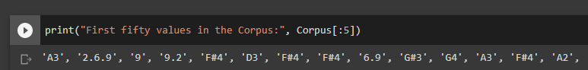
So, in order to train our RNN and LSTM model the MIDI files are converted into Music stream using python tools like Music21.
Music21 - is a Python-based toolkit for computer-aided Musical analysis.
After the training is completed, our model is now capable of generating artificial music which produces music stream which is converted back to MIDI format for perceived output for sensory understanding, this is achieved by our pioneered function. Music stream notation has additional features for representing ornaments, repetitions, and so on.

Slide 14
Sequence Diagram
Understanding basic concepts of Music
Data Collection (MIDI file format)
Data
Pre-processing
LSTM Model implementation
Model Validation
Validated Music Generation

Slide 15
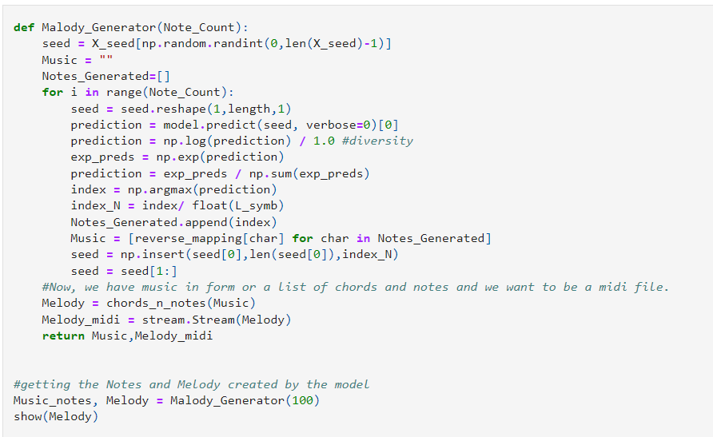
Implementation
This is the code snippet that converts the music stream data to MIDI file format.
Click here to explore the entire code

Slide 16
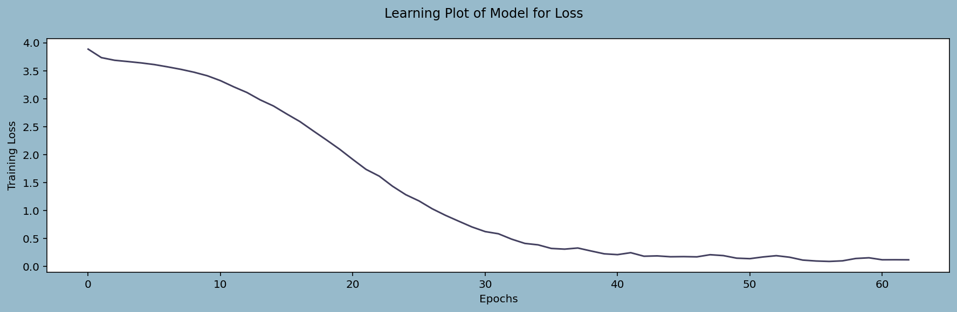
Model Validation
Model Validation
Training Error v/s No. of Epochs

Slide 17
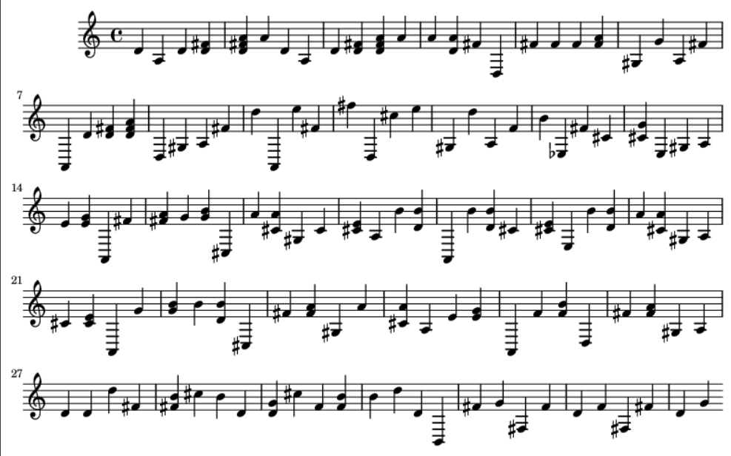

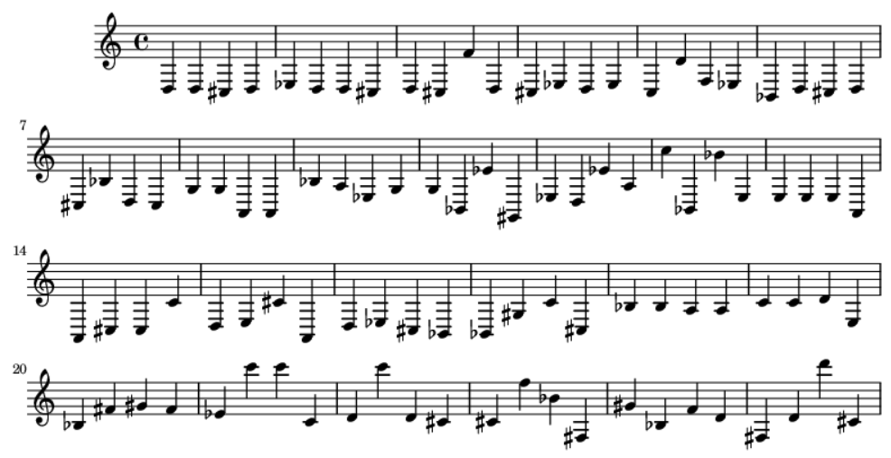
Results
Initially the audio from the dataset scrapped sounds like:
The audio file that we obtain at the end of the entire project cycle is as follows:

Slide 18
Conclusion and Future Scope
LSTMs are a very promising solution to sequence and time series related problems.
As of now, the music generated is of only one piece of instrument. It would be interesting to listen what music the model would produce if it is trained on multi-instrument music.
Also, when provided with genre, and lyrics as input, our model will try to output a new music sample produced.
To try implementing the similar kind of model using Transformers. LSTM or RNN models are sequential and need to be processed in order, unlike transformer models. Due to the parallelization ability of the transformer mechanism, much more data can be processed in the same amount of time with transformer models.
Notes:
Discuss about open ai jukebox and AGI

Slide 19
References
https://analyticsindiamag.com/a-hands-on-guide-to-automatic-music-generation-using-rnn/
https://www.analyticsvidhya.com/blog/2020/01/how-to-perform-automatic-music-generation/
https://magenta.tensorflow.org/datasets/maestro
MIT 6.S191 – Alexandra Amini
Papers:
https://doi.org/10.48550/arXiv.2203.12105
https://doi.org/10.1109/ACCESS.2020.3031155
https://doi.org/10.48550/arXiv.2201.00052
https://doi.org/10.1109/ACCESS.2020.3031155

Slide 20
THANK YOU
Team Members:
Mithun G
Myil Vaughanan V L
Sunaina Naikodi
Varshini D
Mentor:
Dr Mohammed Zabeeulla A N

